Slide 1


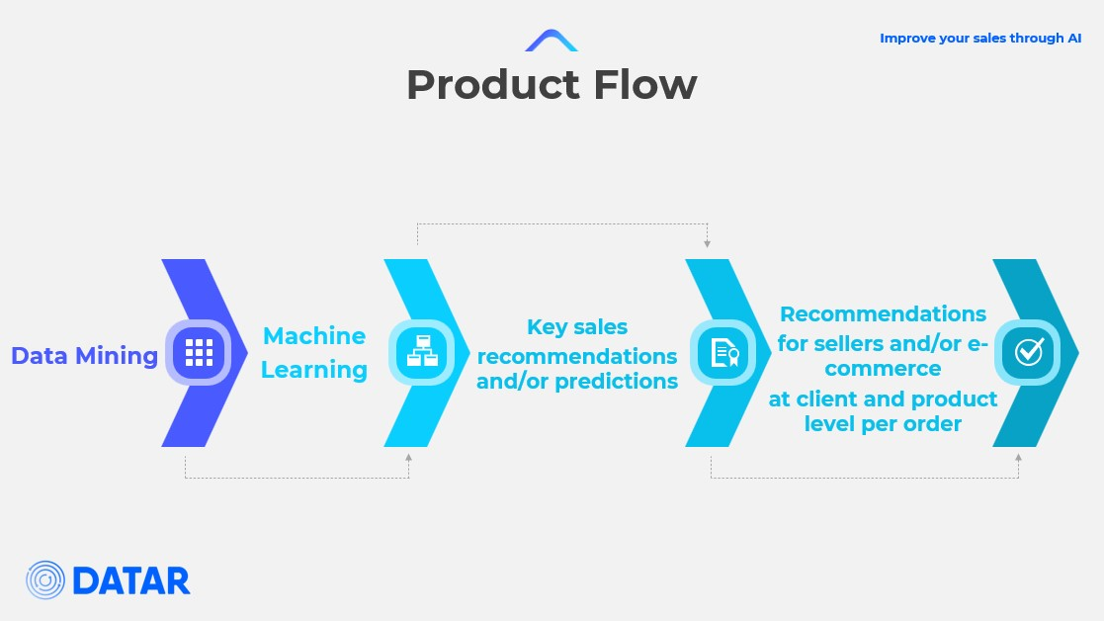
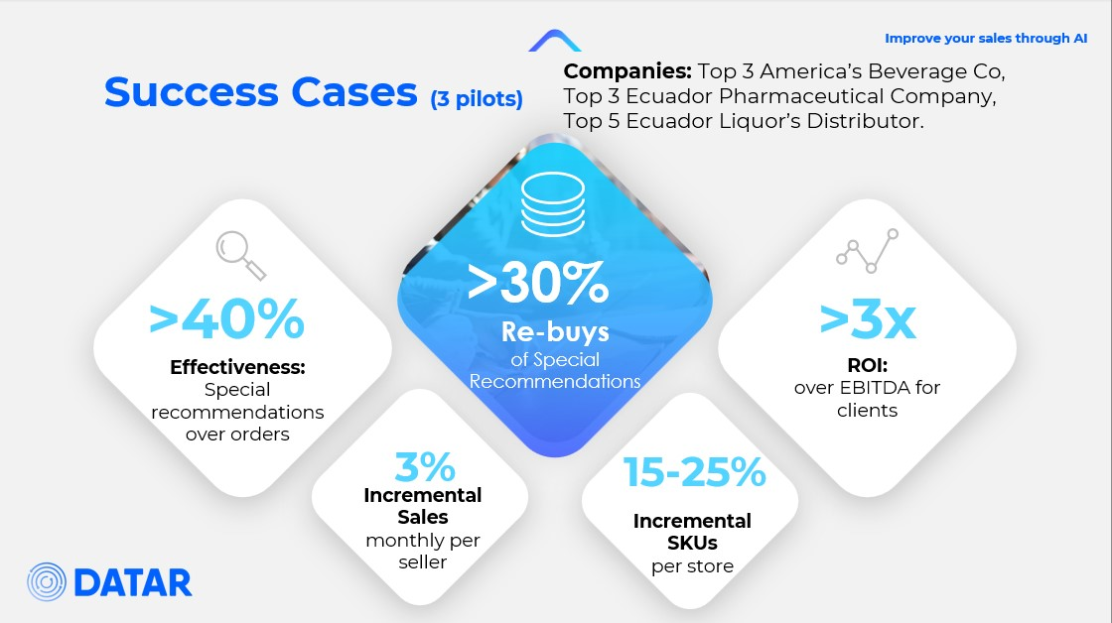
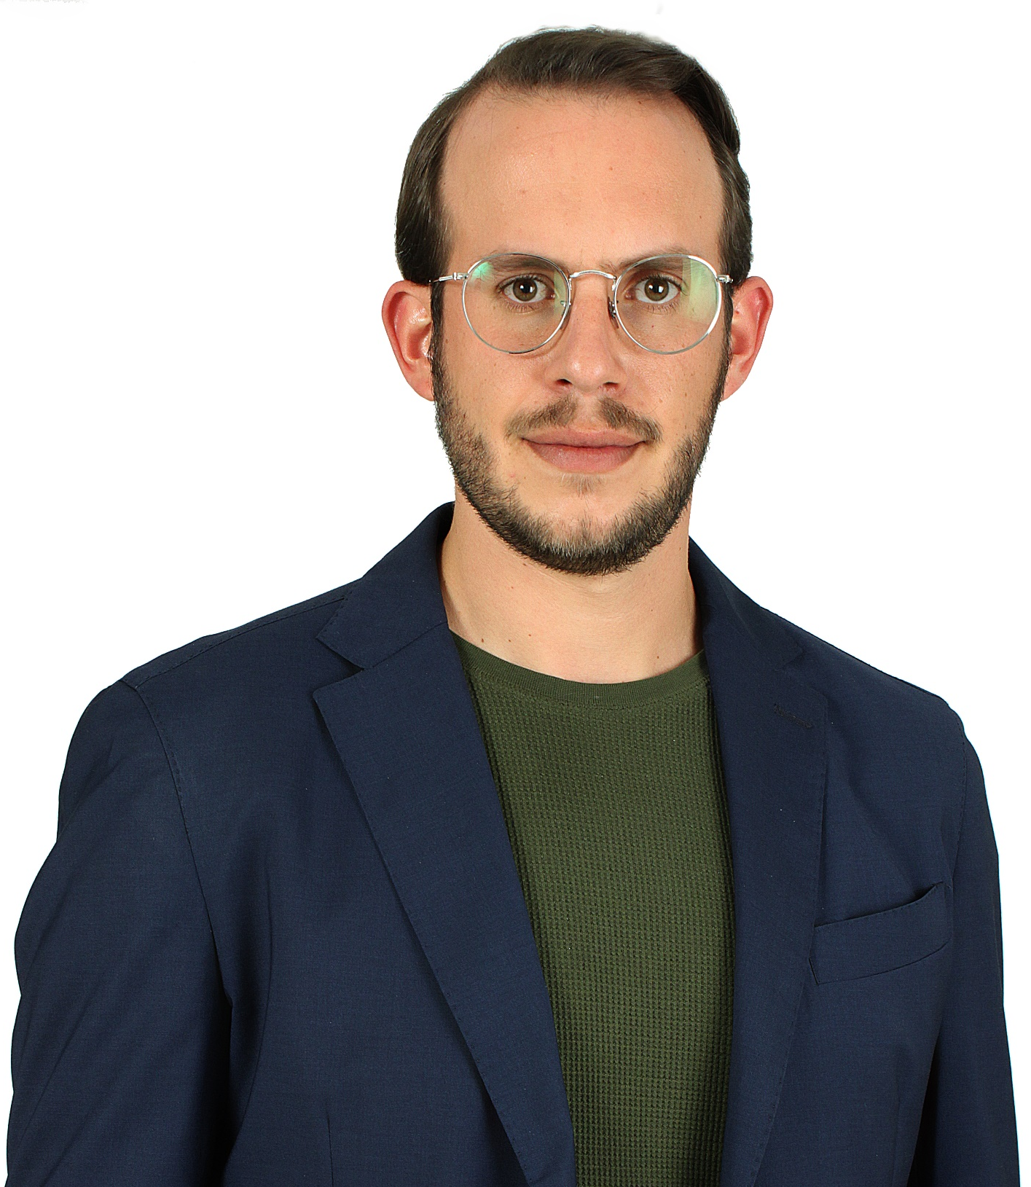
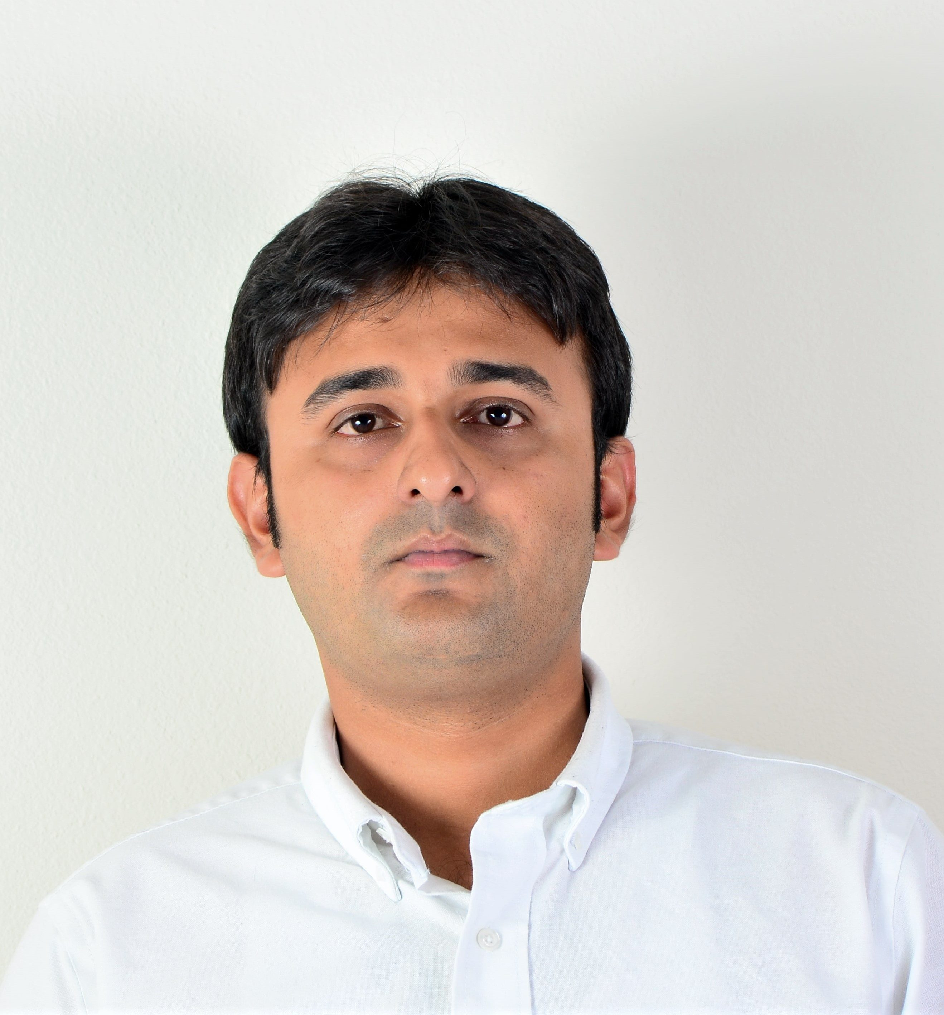
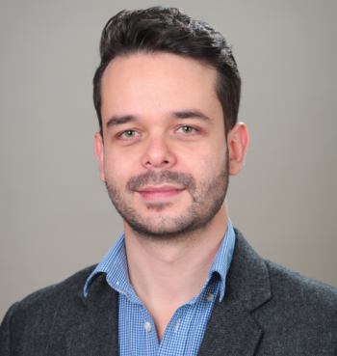
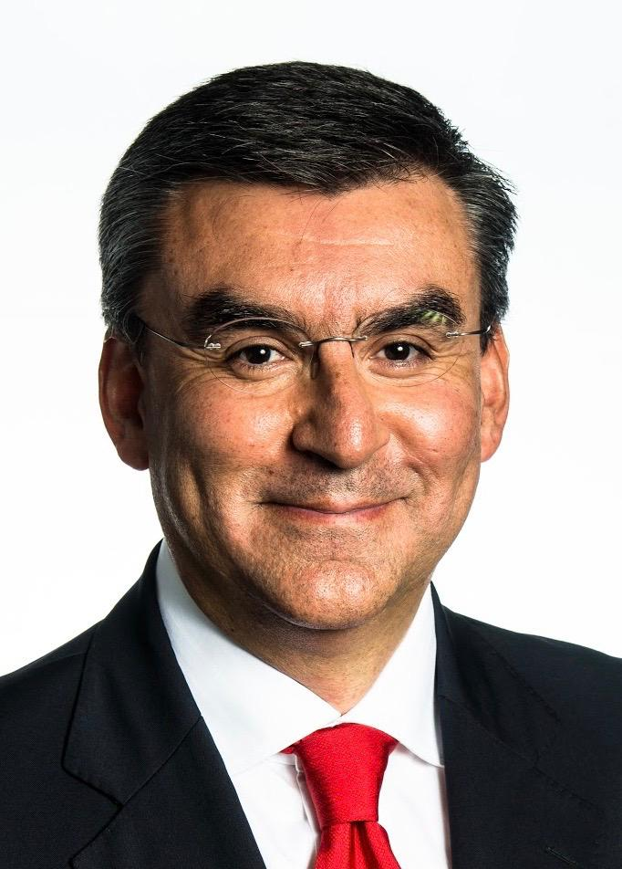
Plug-&-Play Commercial AI for your business
Companies want to grow their revenues and customer engagement in a more efficient way with less or at least the same resources.
DATAR provides Artificial Intelligence driven solutions, to help companies improve sales force performance at the point of sale. We enable companies to focus their interactions on unreplaceable human value-added activities while replacing and improving with digital technologies the data driven activities such as suggested orders, promotions makers, and forecast among others.
Platform’s Modules
SUGGESTED ORDER
Having to select which products to offer from an extent portfolio or humanly defining fixed clients’ clusters and prioritize products for each of them is inaccurate most of the time. We reduce full companies’ product catalogue to a short-suggested order per store per visit, including the best options of not current portfolio of the store to increase sales and shelves’ share along with regular products to prevent out of stocks and maintain variety. Expanding clients’ product portfolio in the process.
PROMOTIONS’ MAKER
Product combinations is an extremely large list that isn’t manageable for known technologies, causing not accurate promotions to be sold by the commercial team or an unnecessary give-away of profit. We suggest the best variety and quantity promotions for critical products maximizing investment’s usage on them. Also including which clients must access each promotion.
FORECASTS
Usually, companies have a high waste of certain products or raw materials, along with out of stock of others. We improve accuracy in forecast for mid-term and short-term time frame to improve supply chain and reduce waste, also for detecting commercial tactical moves for critical performance products.
SALES’ BUDGET SPRAYING
Allocating a proper (challenging but reachable) budget per seller has a huge impact on sales’ teams (~20% - 35%). We split total budget using your existing data and tactical inputs in a way that some sellers won’t have an unreachable goal and some others to over accomplishing it easily and not capturing most of market opportunity
Testimonials
FMCG Global Sales Development and Innovation Coordinator: ”In the market follow-up I did with sellers, an average 8 out of 10 stores increased at least one product that they didn’t buy before with Datar’s suggested order usage. This made the sellers to believe in what they’re offering to store owners, which is key to the performance on each visit.”
Pharmaceutical industry seller: ”Datar’s suggested order has helped me to focus on the best new products to the drug stores and check inventory and re-supply low stock products. That makes achieving my monthly objectives easier.”
FMCG seller: ”Datar’s suggested order has allowed me to show the store owners in which products they’re losing sales’ opportunities by not buying them and offering them to their shoppers. Most of the store owners understood that and that’s how I’ve increased the coverage of the suggested products along with sales.”
Team
Alexis Platonoff
CEO / Co-founder
Anjan Paul
CTO / Co-founder
Felipe Oviedo
ML Advisor / Co-founder
Guillermo Aponte
Advisory Board Member
Commercial and marketing FMCG expert.
1st place in the Global Coca Cola Awards 2015, in the service models optimization category.
Developed several algorithms for FMCG companies.
10 years working in Data Engineering, Big Data and Cloud Computing.
Experience developing data infrastructure for Fortune 200 companies in the US, Europe and India.
Certified developer in: IBM Watson, Amazon Redshift and Spark.
Machine Learning PhD at MIT.
Conducts research in the area of machine learning and materials science.
Fellow in Study of the U.S. for Students Leaders 2011, and Fellow at CERN, Switzerland 2013.
More than 20 Machine Learning publications and 1 patent
Arca Continental (3rd largest Coca-Cola Bottler worldwide)
CEO – South America Division
CEO – USA and Latam Food & Snacks Division
The Coca-Cola Company
President and GM, Philippines, Mexico, Colombia
CEO & Founder SrtatVizor LLC
Diaz Foods (USA), Board of Directors
Source to Bottle (USA), Advisory Board

